Slide 1
MAB Zooplankton Distribution: What We Know So Far
Delphine Mossman
2025

Slide 2
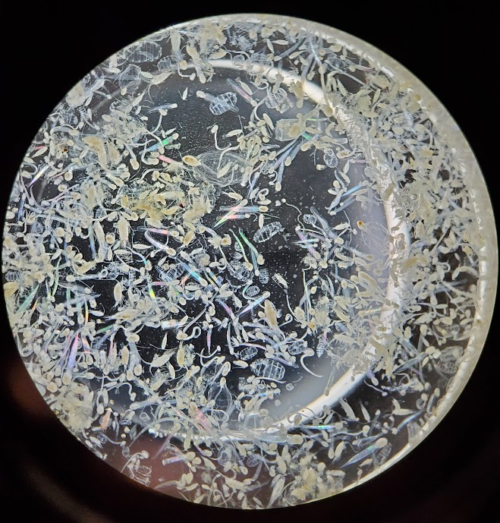
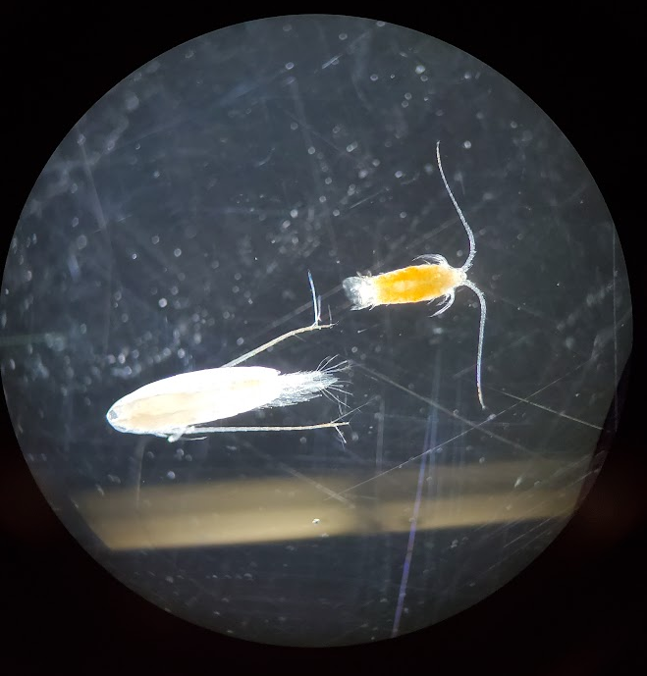
Brief Orientation
Copepods
Centropages spp.
C. finmarchicus
Gelatinous zooplankton (salps, Oikopleura, doliolids, etc)
Notes:
Quick terminology for the slides
Large copepods – C. finmarchicus and other calanoid copepods, ~3 mm in prosome length
Small copepods – Centropages spp only one example but any copepods that are 1 mm or smaller in prosome length qualify
Samples also had gelatinous zooplankton in them, but not calculating their concentrations here because it’s hard(er)

Slide 3
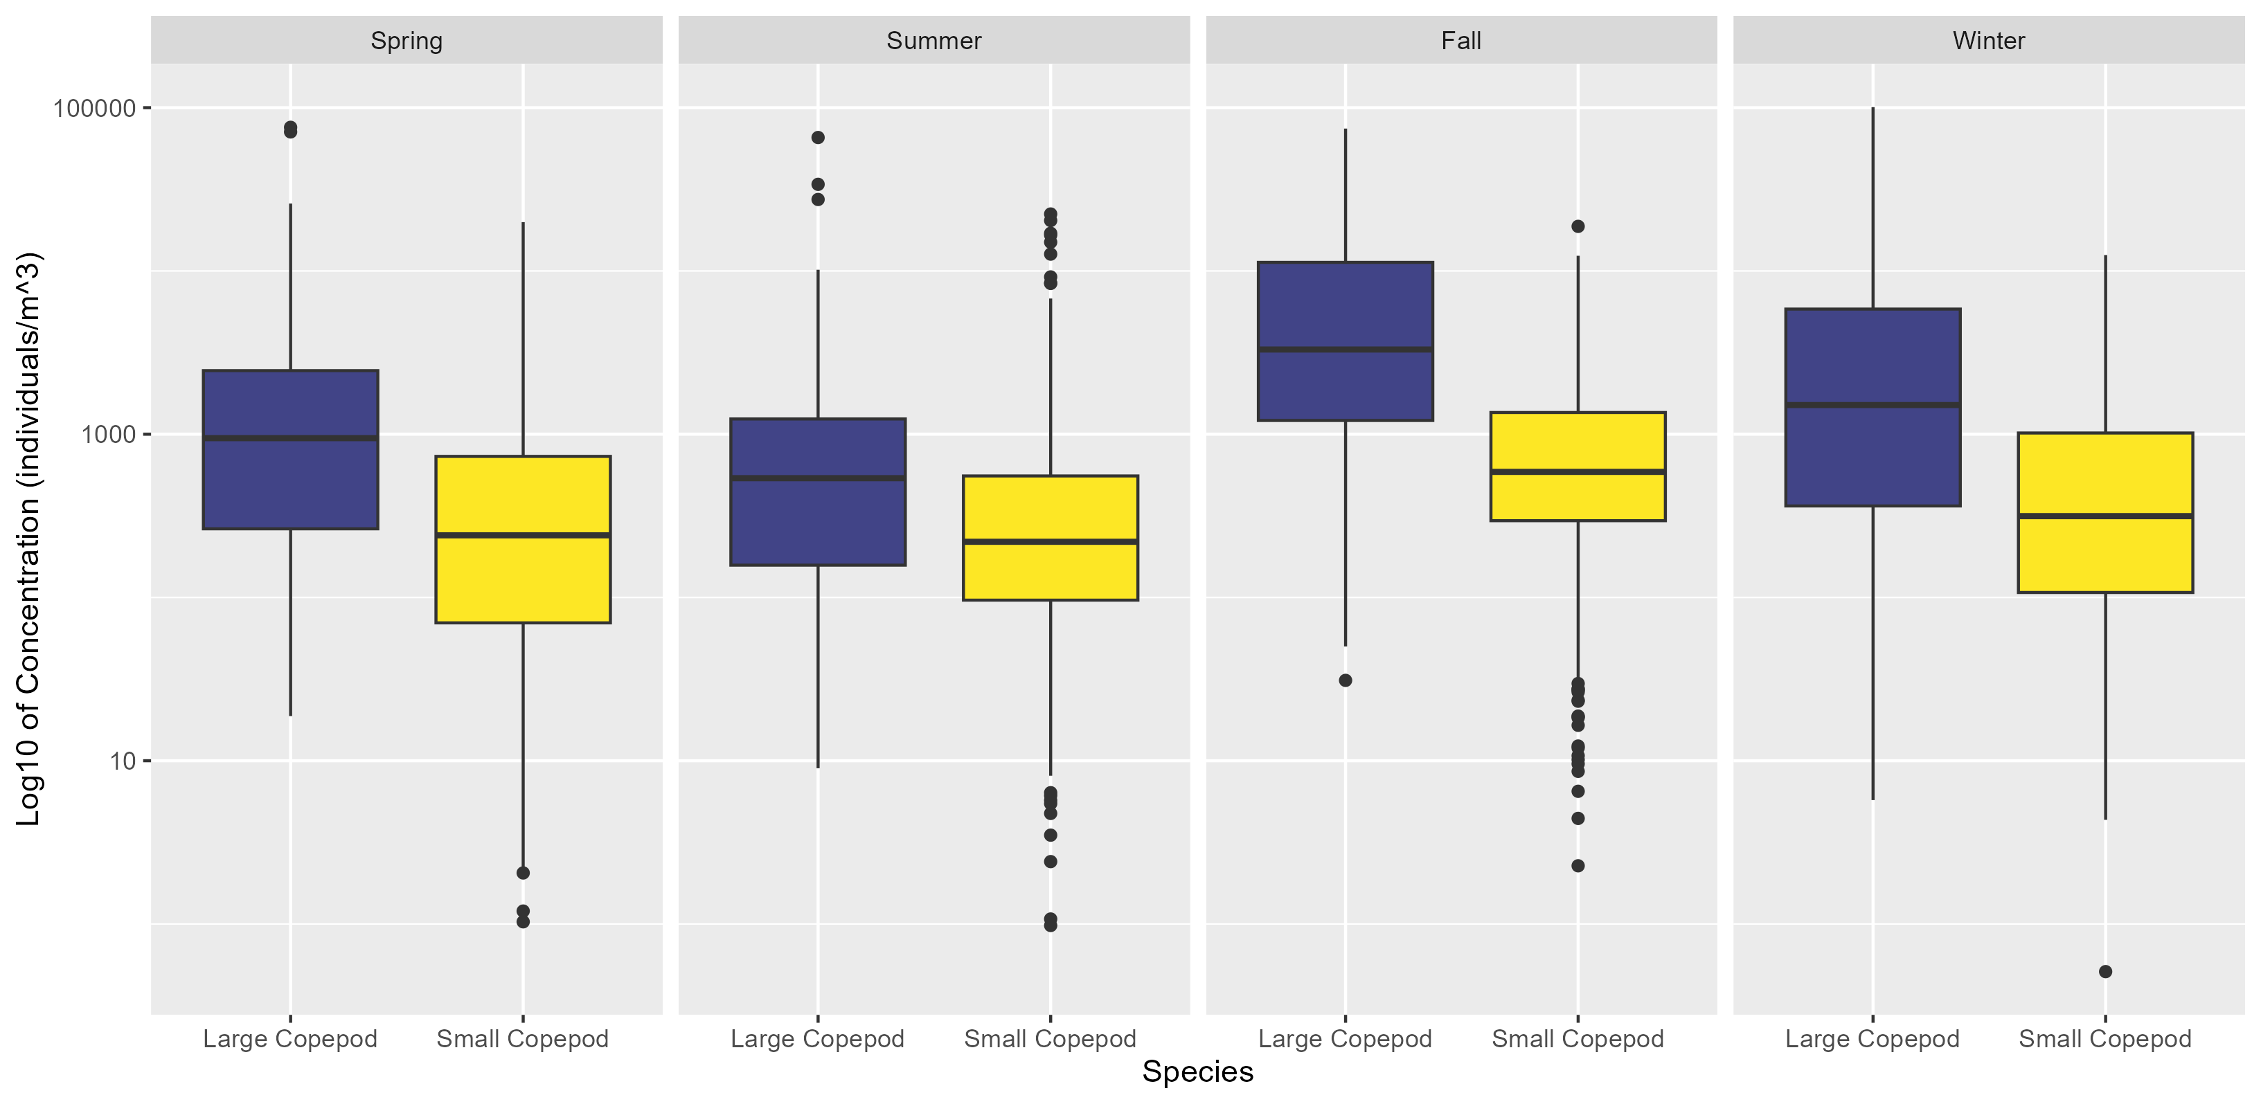
Abundance By Season & Species
Notes:
Large copepods had highest concentrations in fall, gradually decrease through to the summer before jumping up again – consequence of cold pool formation/breakdown?
Small copepods stayed more constant

Slide 4
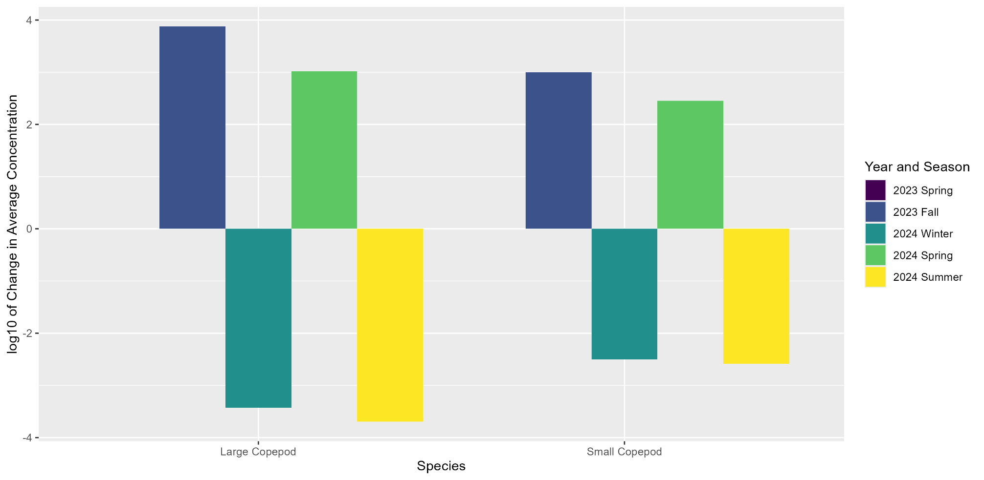
Seasonal Changes In Abundance By Species
∆ is relative to previous year’s abundance numbers (2023 Spring is set to 0); log was taken after difference was calculated (i.e. it is not a difference in the log of abundances, it is the log of the difference of raw abundances)
Notes:
Increase from spring to fall, decrease from fall to winter, increase from winter to spring, decrease from spring to summer

Slide 5
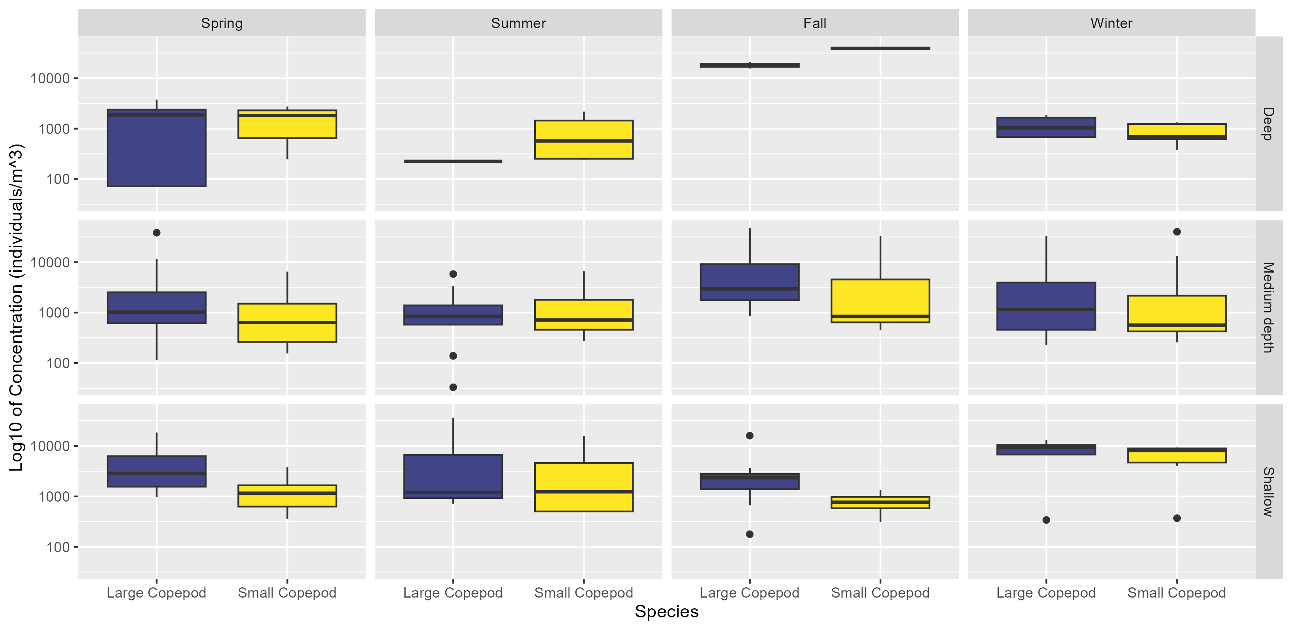
Concentration By Species & Depth Bin
Notes:
Binned by seafloor depth; deep is >70m, medium is 40-70m, shallow is <40m
See a large increase in large copepod concentration in the deep water in fall (low sample size though)
Least dramatic change in medium depths
Shallow waters had highest concentrations of large copepods in spring
Large copepod concentrations increased with decreasing depth in every season except fall, where pattern is reversed (increase with increasing depth)

Slide 6
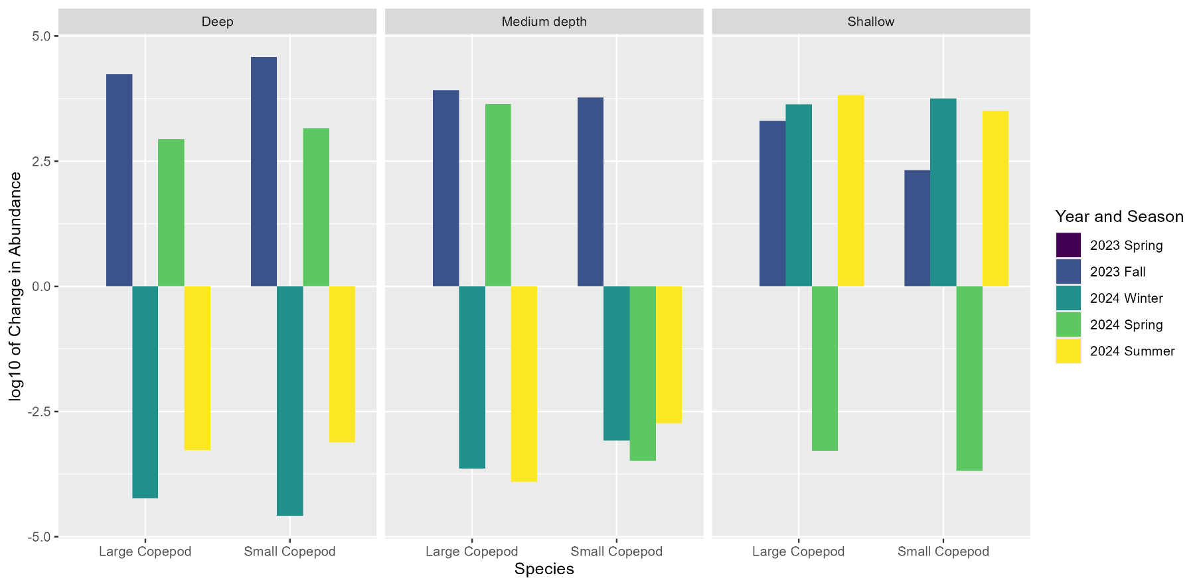
Seasonal Changes In Concentration By Species & Depth Bin
∆ is relative to previous year’s abundance numbers (2023 Spring is set to 0); log was taken after difference was calculated (i.e. it is not a difference in the log of abundances, it is the log of the difference of raw abundances); depth integrated values (ind/m²) in 20 km-long bins
Notes:
Deep and mid depths had same pattern as overall seasonal changes for large copepods
Shallow increased in both fall and winter, then decreased in spring, then increased again in summer

Slide 7
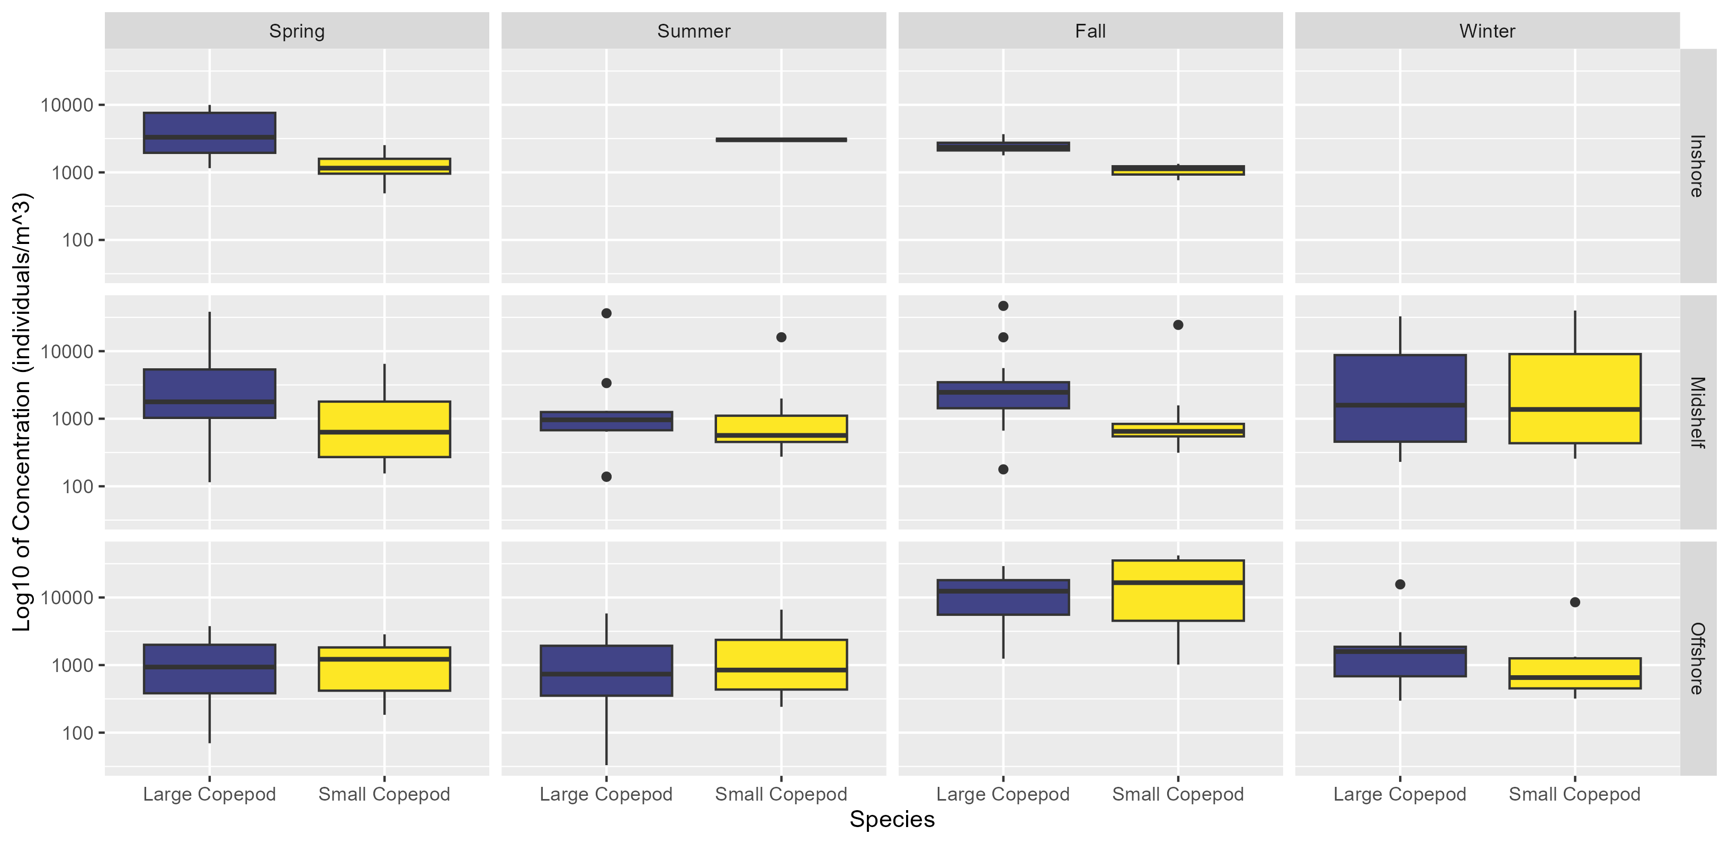
Concentration By Species & Shelf Type
Notes:
Inshore/Midshelf/Offshore designations from NOAA (thanks Lori!!!)
Hard to draw any conclusions about inshore concentrations due to low sample sizes
Stable concentrations in midshelf
Concentrations decrease from inshore to midshelf in spring, reversed in fall, more stable in summer/winter (low sample sizes)

Slide 8
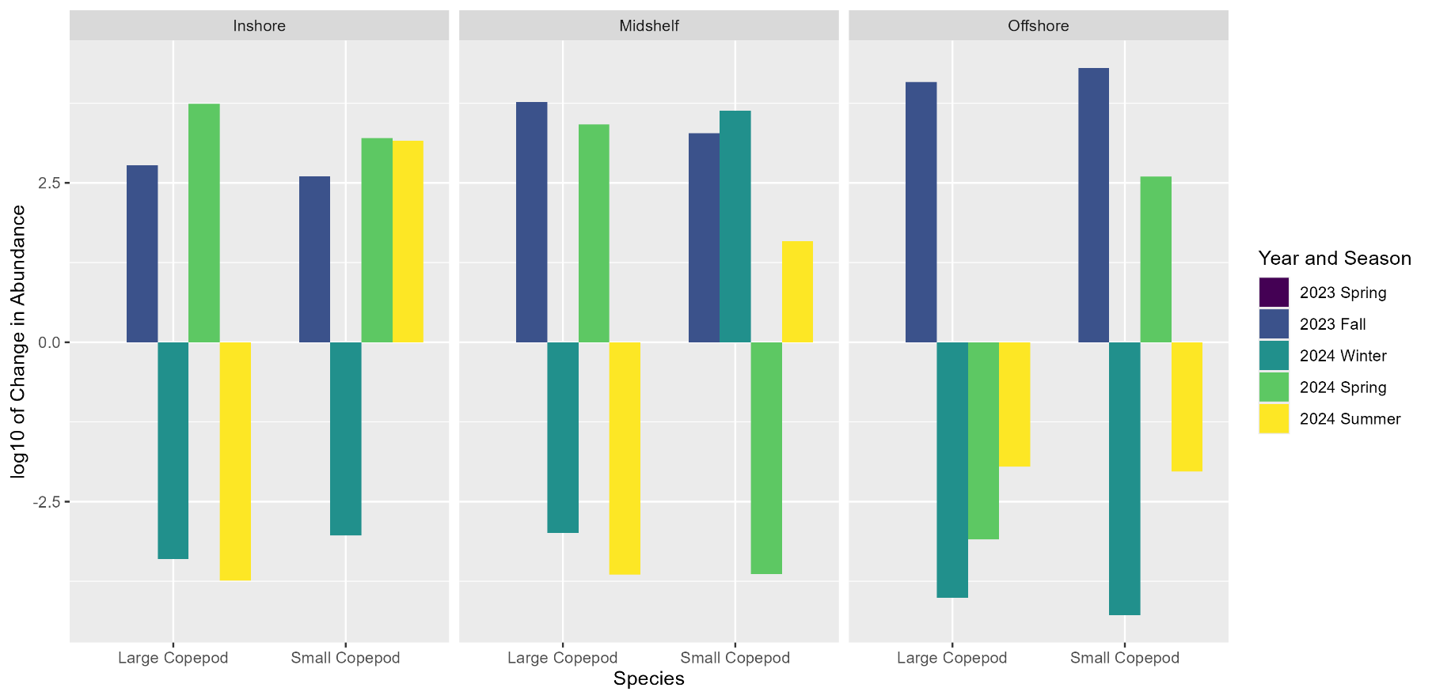
Seasonal Changes In Concentration By Species & Shelf Type
∆ is relative to previous year’s abundance numbers (2023 Spring is set to 0); log was taken after difference was calculated (i.e. it is not a difference in the log of abundances, it is the log of the difference of raw abundances); depth integrated values (ind/m²) in 20 km-long bins
Notes:
Inshore and midshelf had similar patterns in concentration changes, offshore increased in fall then decreased every season after (albeit with a smaller magnitude of change every season)

Slide 9
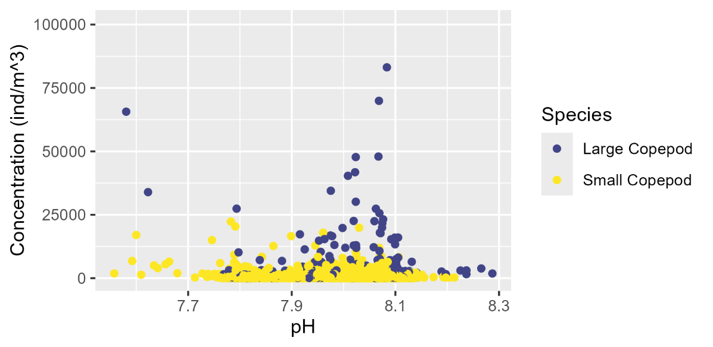
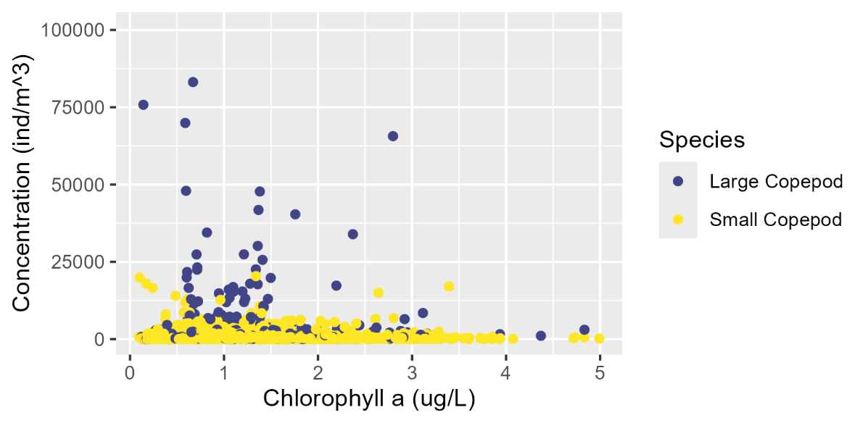
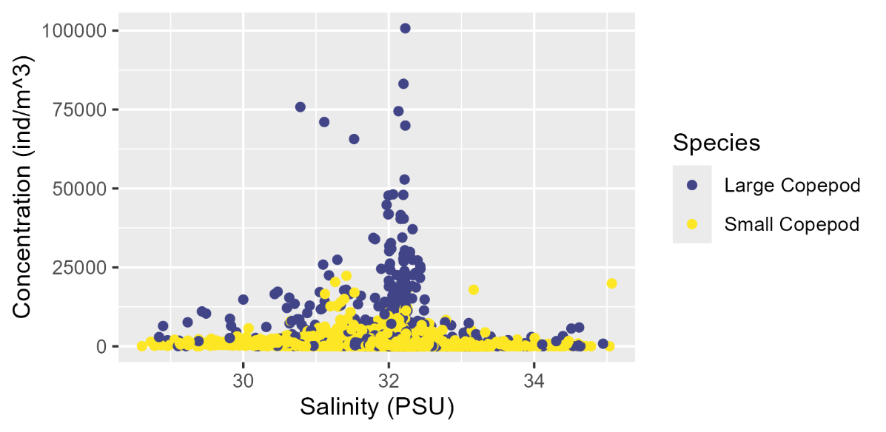
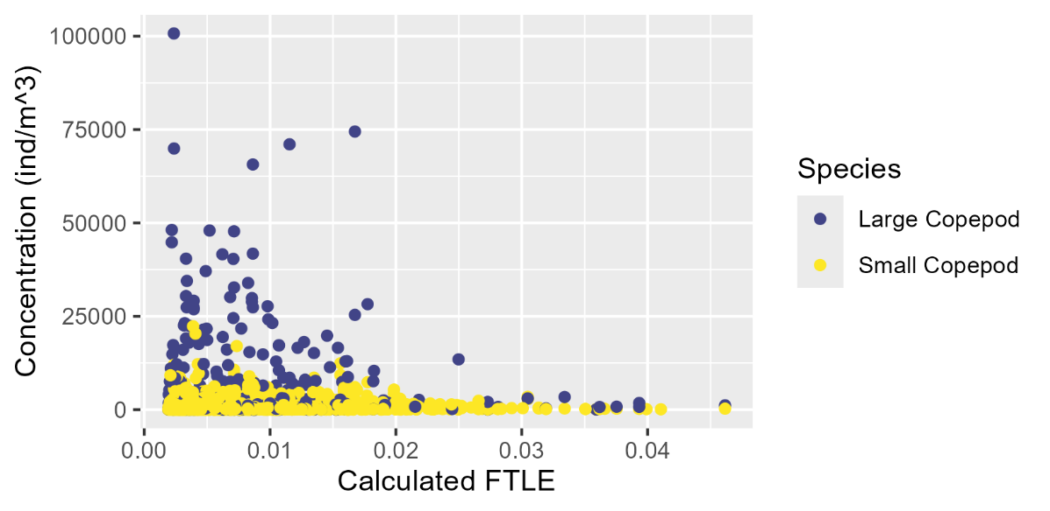
Concentration Distribution by Oceanographic Variable(s)
Notes:
Would like to try and model concentration using oceanographic variables, starting by just looking at XY distribution of concentrations of large/small copepods by each individual variable
pH and salinity are pretty unimodal (linear model would be good); chlorophyll and FTLE are slightly less clear

Slide 10
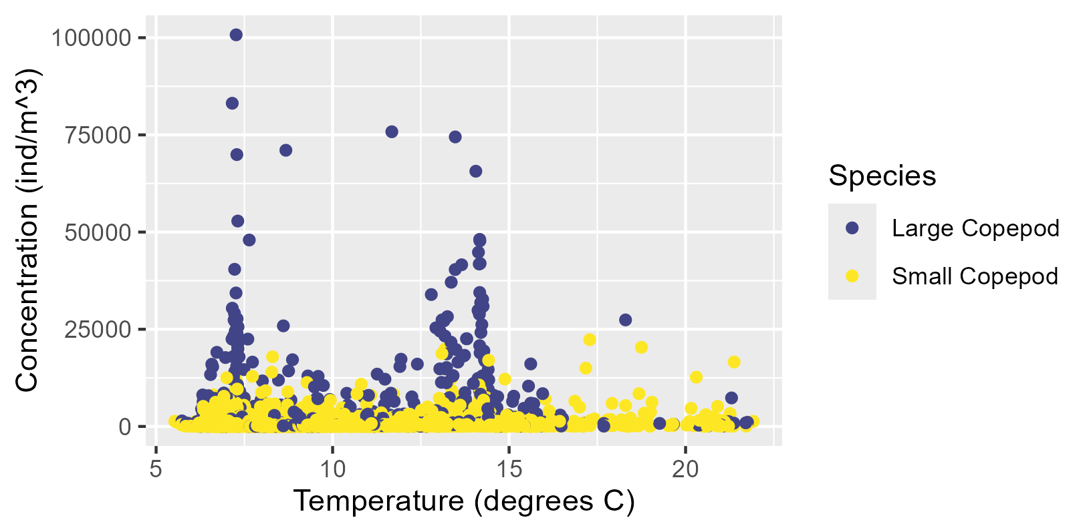
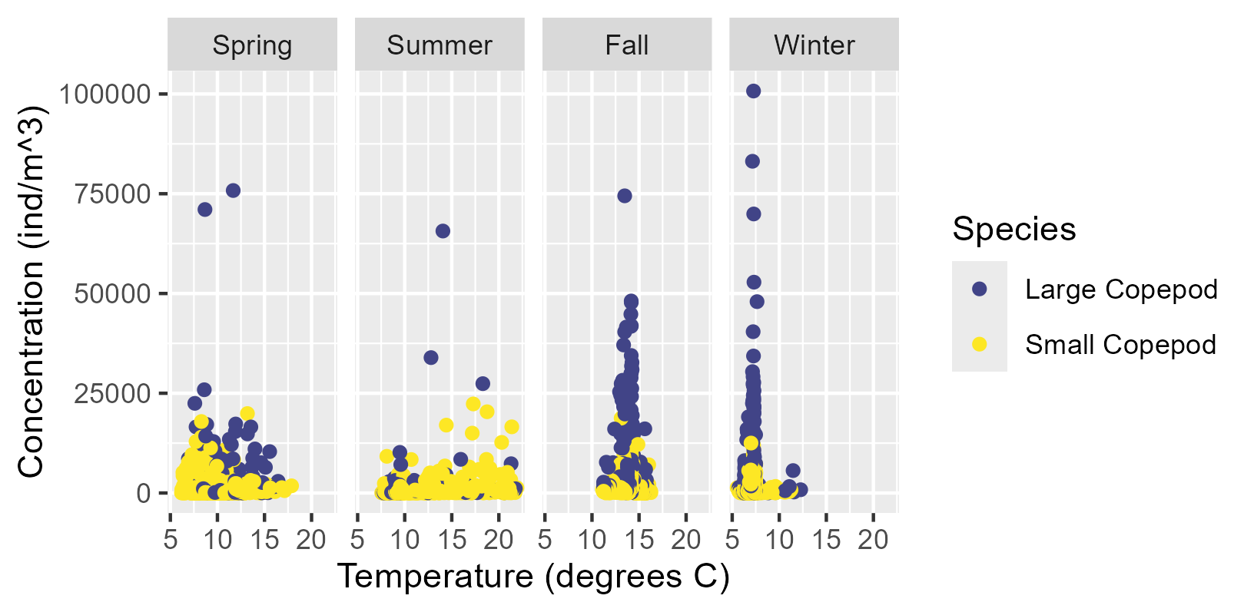
Concentration Distribution by Oceanographic Variable(s)
Notes:
Temperature plot is overall multimodal, as expected
When separated by seasons, each season looks more unimodal

Slide 11
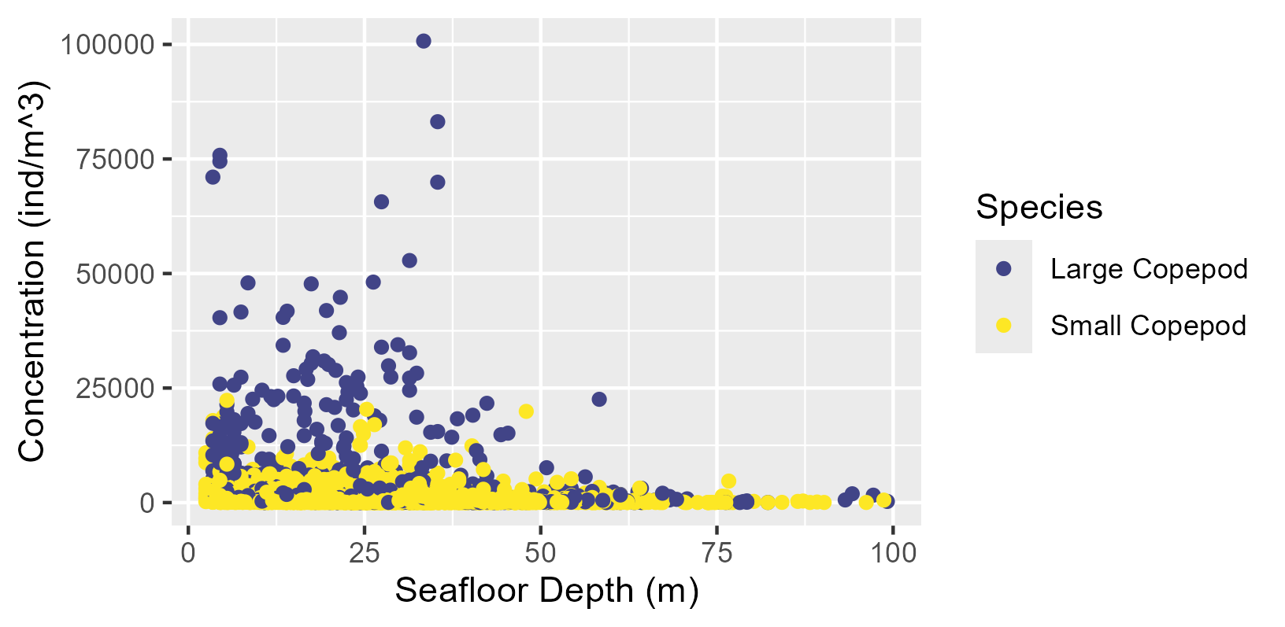
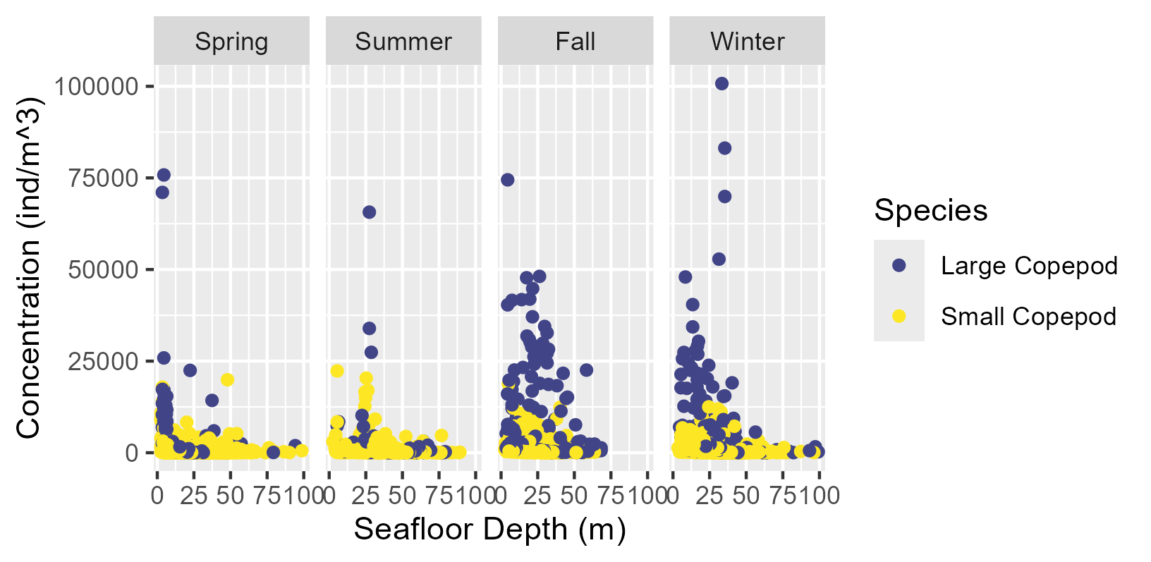
Concentration Distribution by Oceanographic Variable(s)
Notes:
As with temp, depth is multimodal overall but unimodal-ish when separated by seasons; consequence of cold pool/mixed layer depth

Slide 12
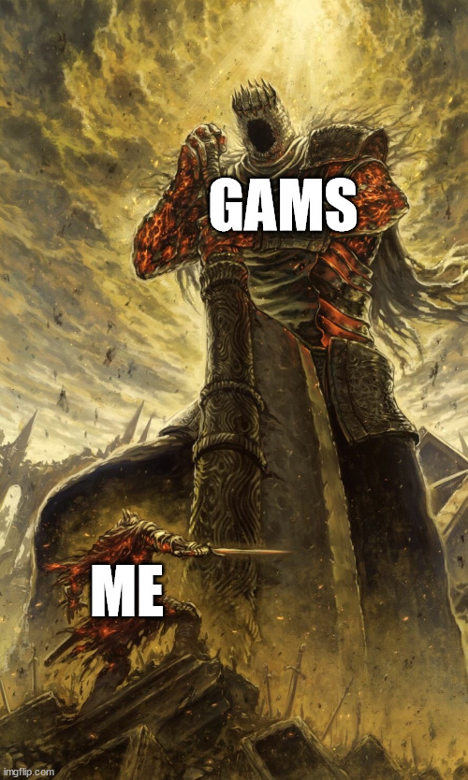
What’s Next
Synthesis of zooplankton abundance over time (what does it all mean?)
Researching attempts at understanding gelatinous zooplankton concentration/biomass from acoustics
Attempting to build predictive models of zooplankton (copepod) concentration using generalized linear/additive models

Slide 13
Questions? Comments? Concerns?

Slide 14
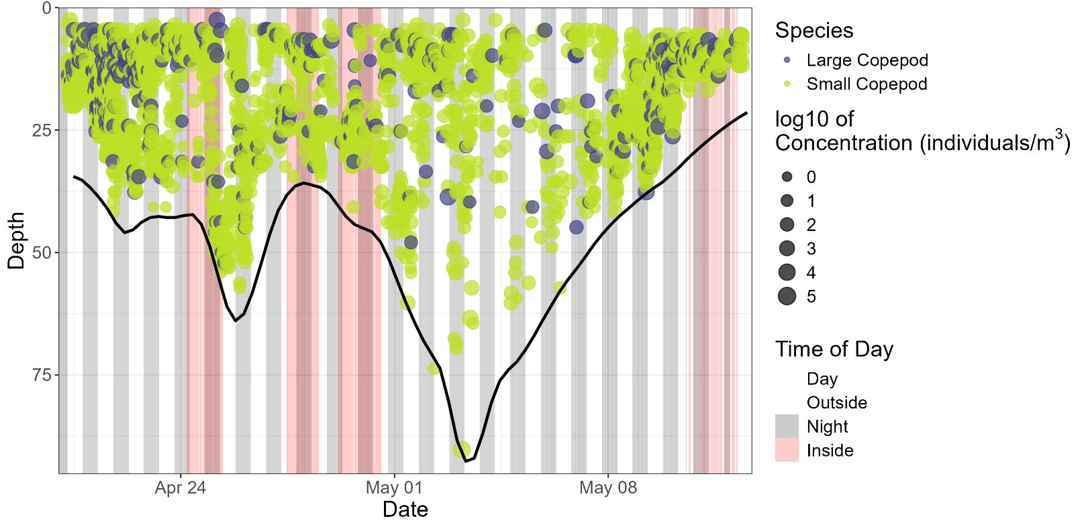
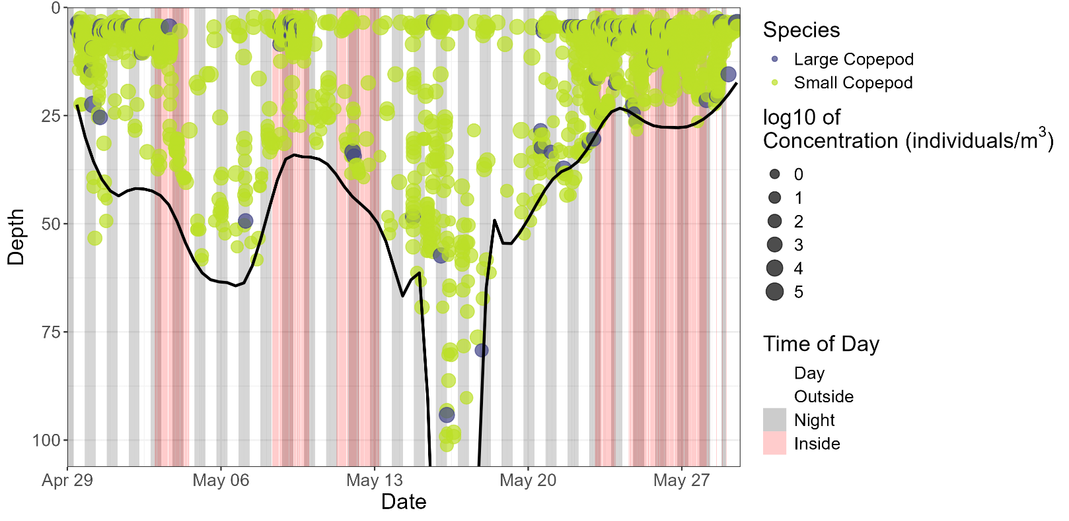
Depth-Stratified Plots
Spring (2023)
Spring (2024)

Slide 15
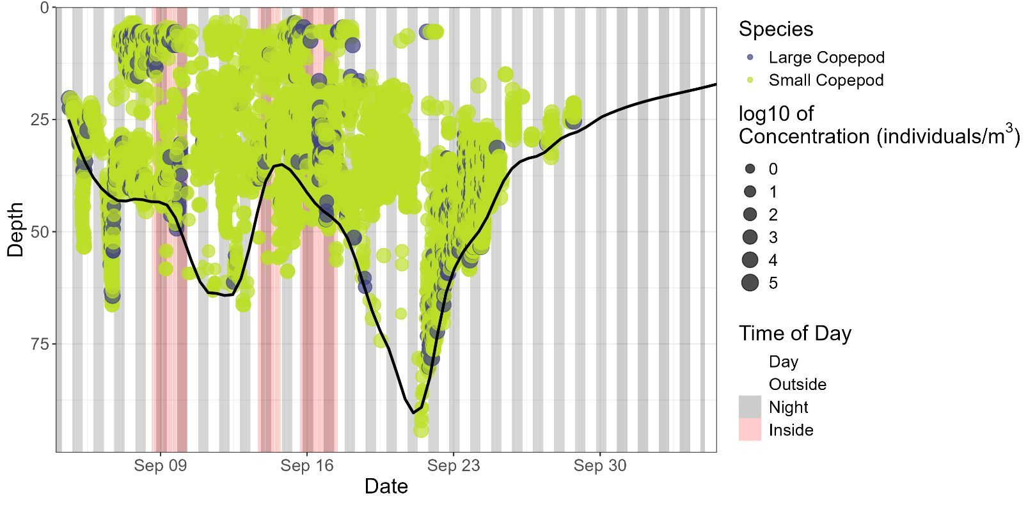
Depth-Stratified Plots
Summer (2024)

Slide 16
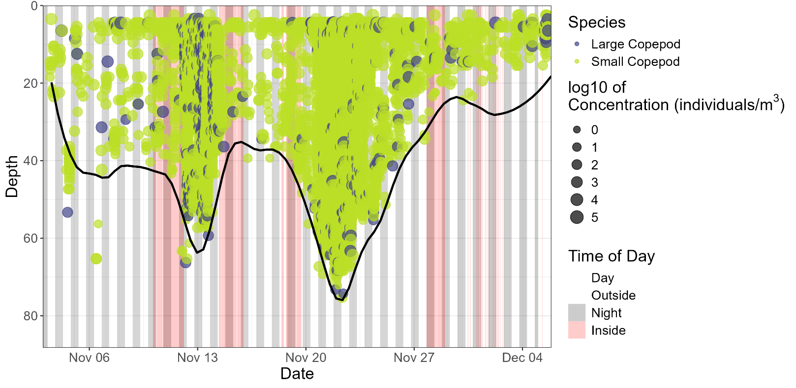
Depth-Stratified Plots
Fall (2023)

Slide 17
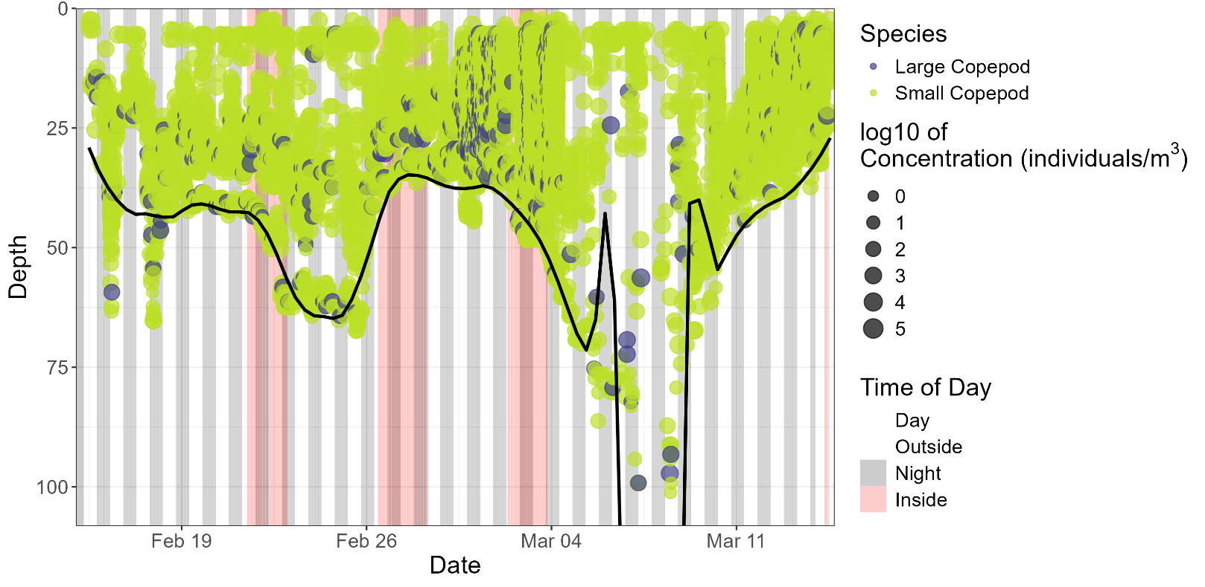
Depth-Stratified Plots
Winter (2024)

Slide 18
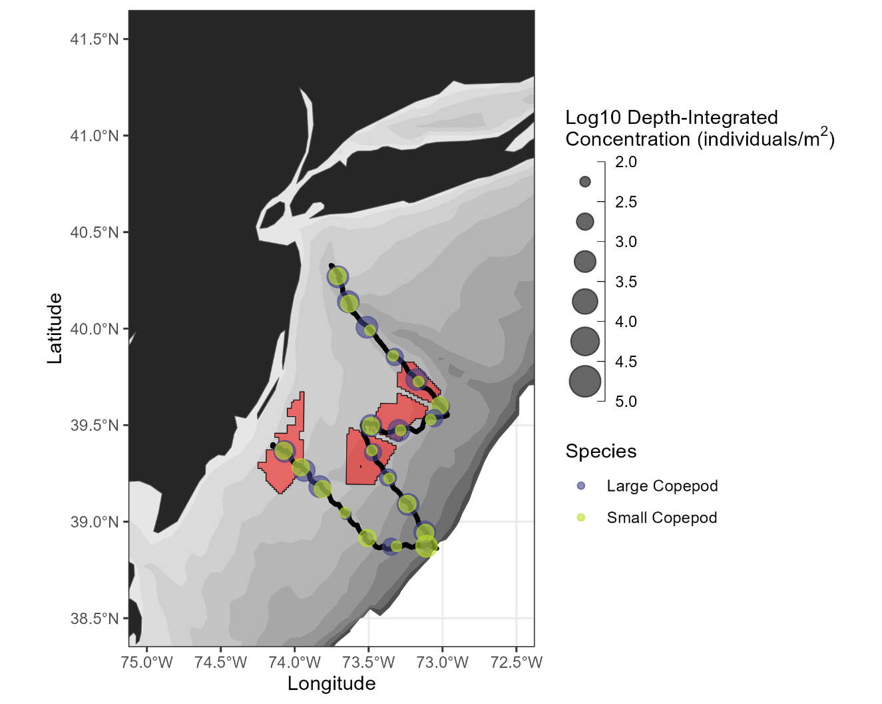
Depth-Integrated Plots
Spring (2023)
Spring (2024)

Slide 19
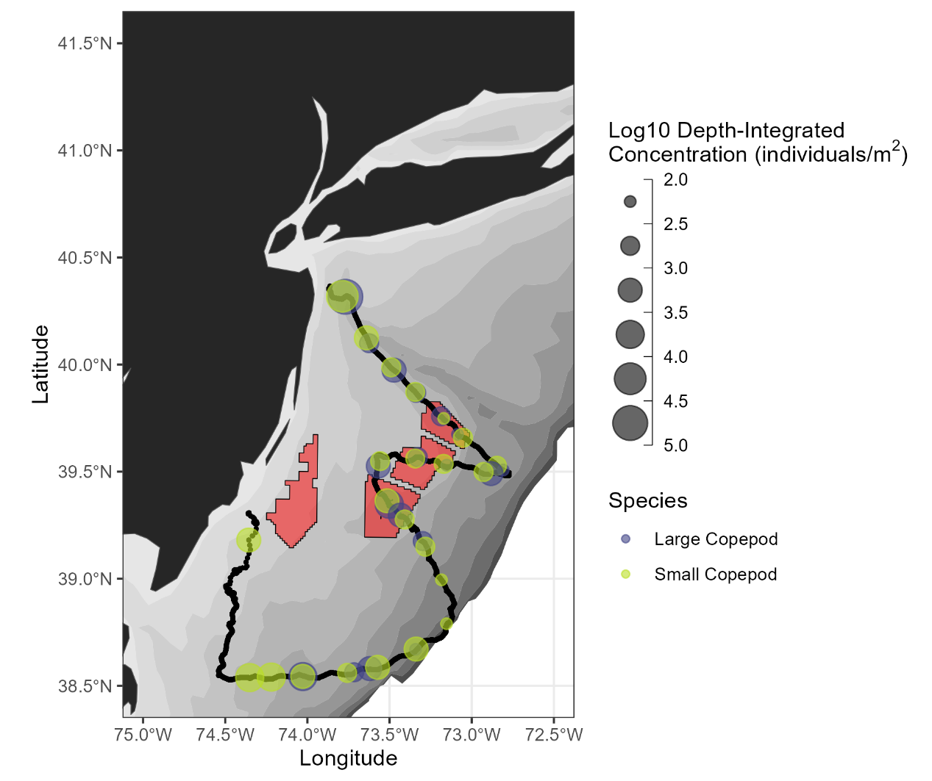
Depth-Integrated Plots
Summer (2024)

Slide 20
Depth-Integrated Plots
Fall (2023)

Slide 21
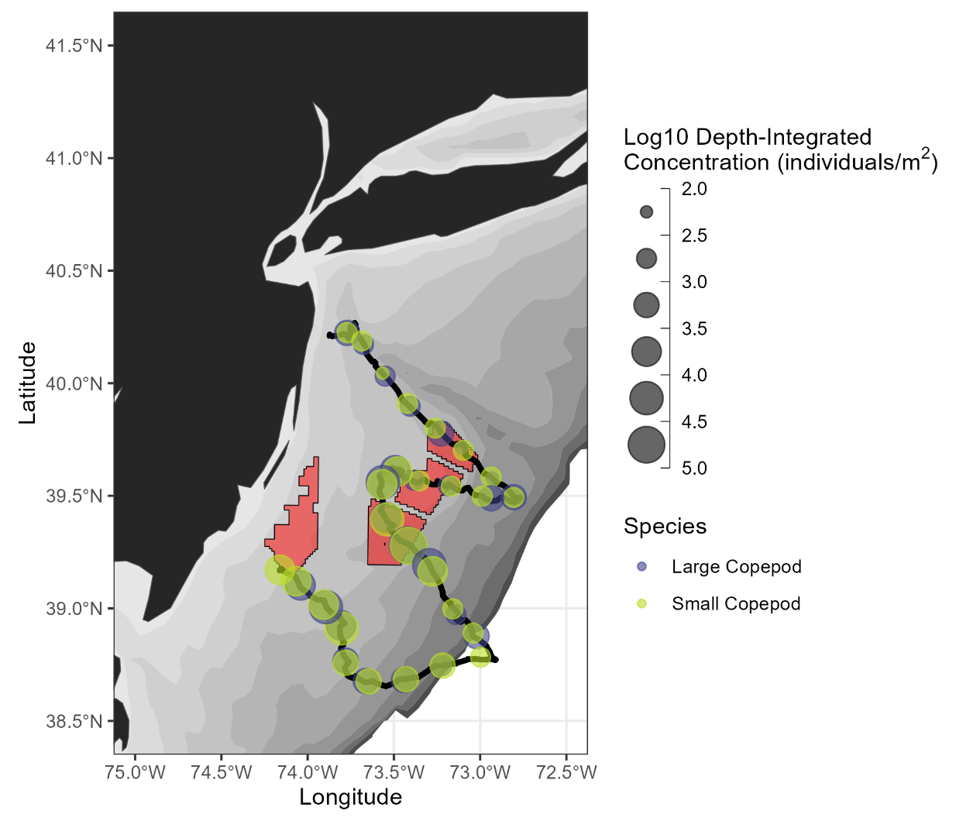
Depth-Integrated Plots
Winter (2024)

Slide 22
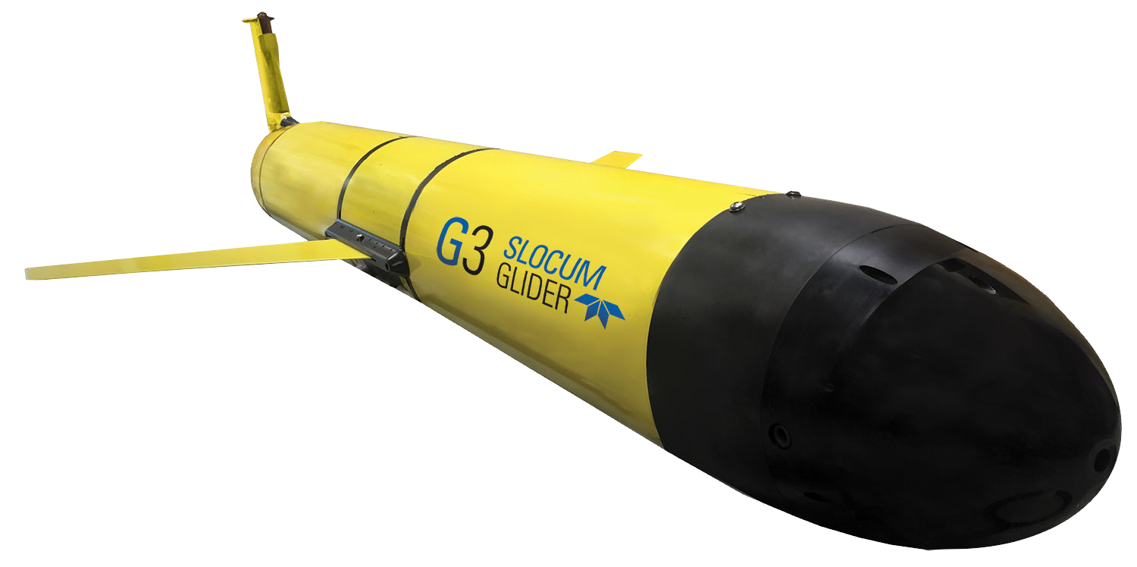
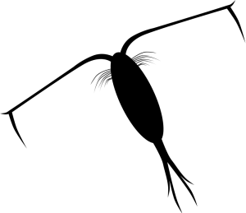
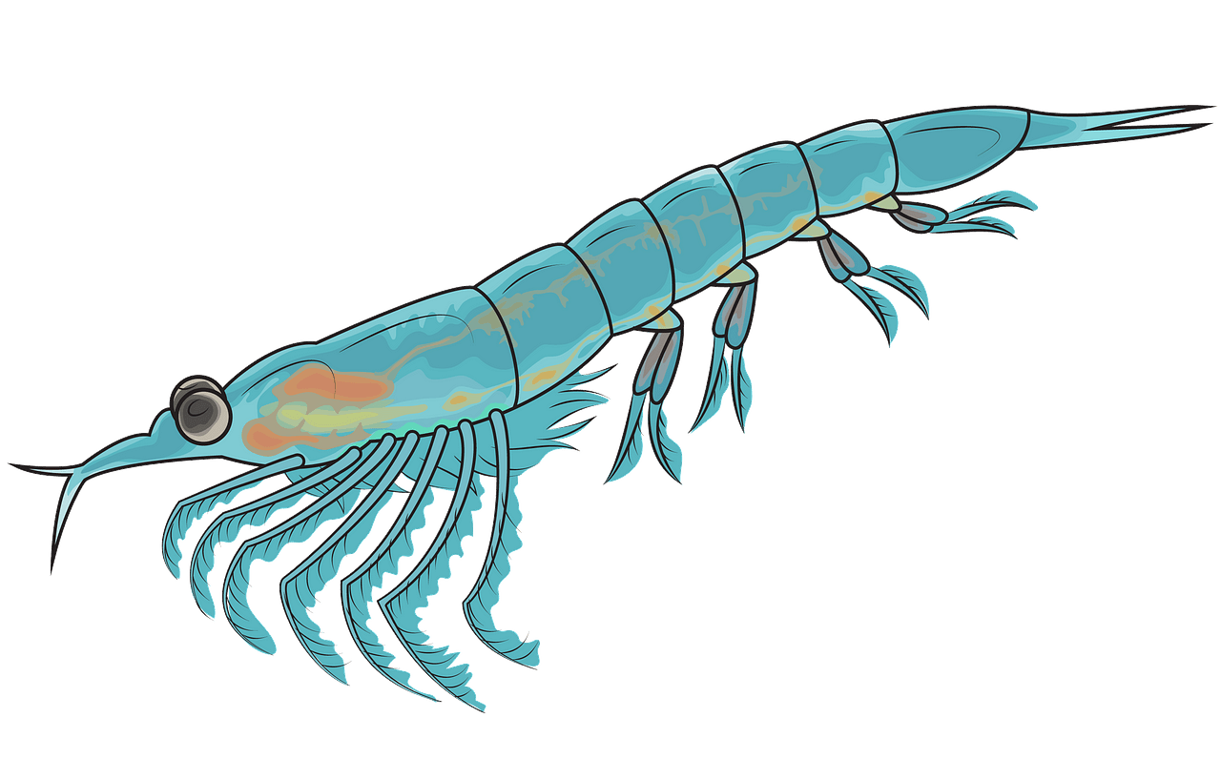
Notes:
Glider path diagram

Slide 23
Ping 1
Ping 2
1.
Sample 1: 200 kHz
Sample 2: 455 kHz
Sample 1: 200 kHz
Sample 2: 455 kHz
2.
Sample 1 Result: -80 dB
Sample 2 Result: -66 dB
Sample 1 Result: -60 dB
Sample 2 Result: -57 dB
3.
Sample 2 – Sample 1 = 14 dB
Sample 2 – Sample 1 = 3 dB
4.
Within difference window of 13.7-14.2 dB? Yes
Within difference window of 13.7-14.2 dB? No
5.
Retain Sample 2
Set Sample 2 to NA
6.
Repeat for all sample pairs in 455 kHz – 200 kHz band
7.
Obtain only echoes consistent with scattering from 1.3-3 mm copepods at 455 kHz

Slide 24
